Slide 1
Adaptive Computation LLC
(ADC)
Sparse Sensor, Hybrid In-Memory Processing Deep Neural Network Processing Unit (HPU) and Machine Intelligence Software applications
Tuan A Duong Ph.D.
Confidential — Copyright © 2026 Adaptive Computation. All Rights Reserved.

Slide 2
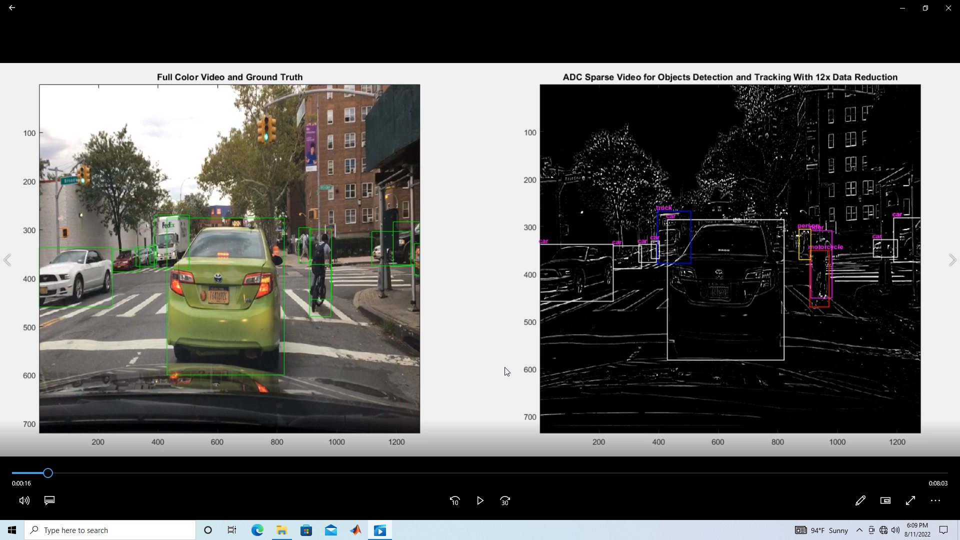
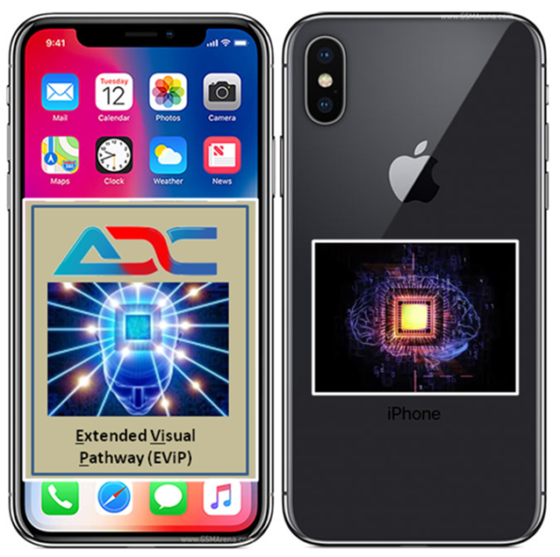
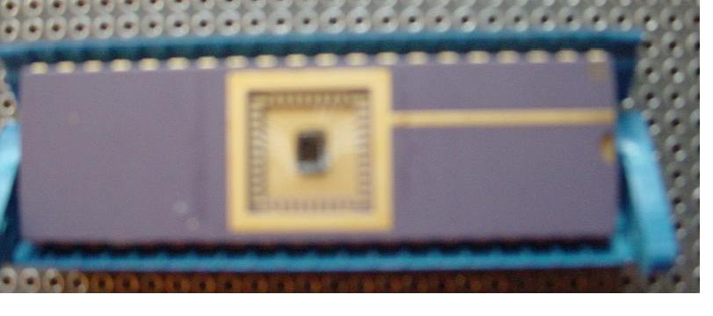
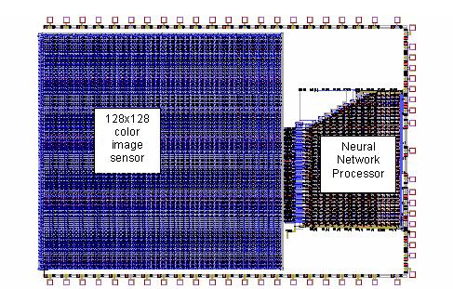
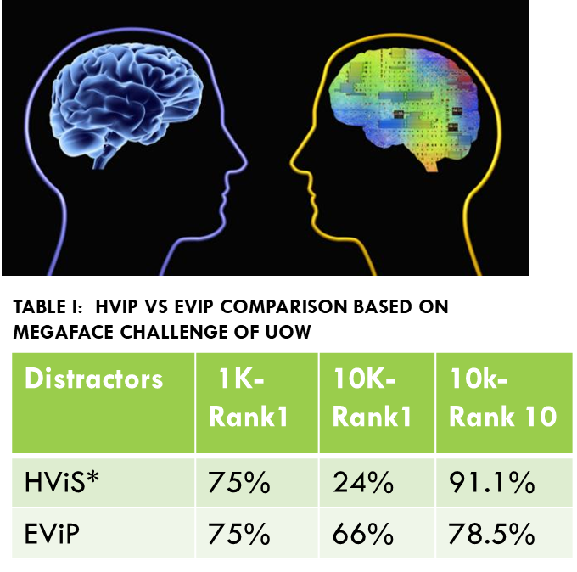
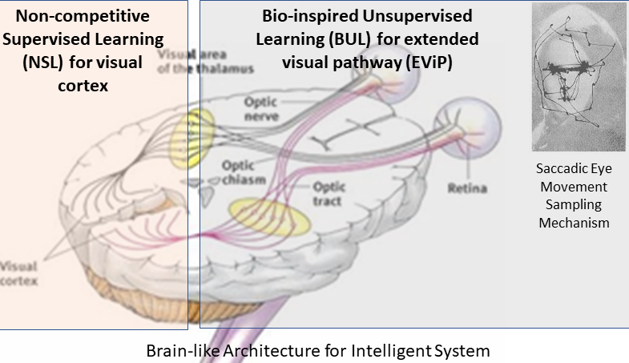
ADC Unique Innovations
Sparse Image (SI): lighter operations and low-cost space operation in visual data → 60x data reduction → military and space application markets
Hybrid In-memory Processing Unit (HPU): fast processing, low power and compact device → over 3 orders of magnitude in faster speed processing and low power consumption → every application market required high speed and low power, e.g., mobile device
Massive Parallel Learning Architecture (MaPLA): updating all weight components in fully parallel → enabling DNN learning time to be reduced from a week to an hour.
Intelligent Software (IS): less data, in-situ data collection and learning → unattended and self-smart system → security, intelligent and exploration system
2 US patents DARPA support
US patent-Caltech Assignee
Ongoing two provisional patents
3 US patents and 2 US international pending patents
Integration of three will put us ahead of the game
Confidential — Copyright © 2026 Adaptive Computation. All Rights Reserved.

Slide 3

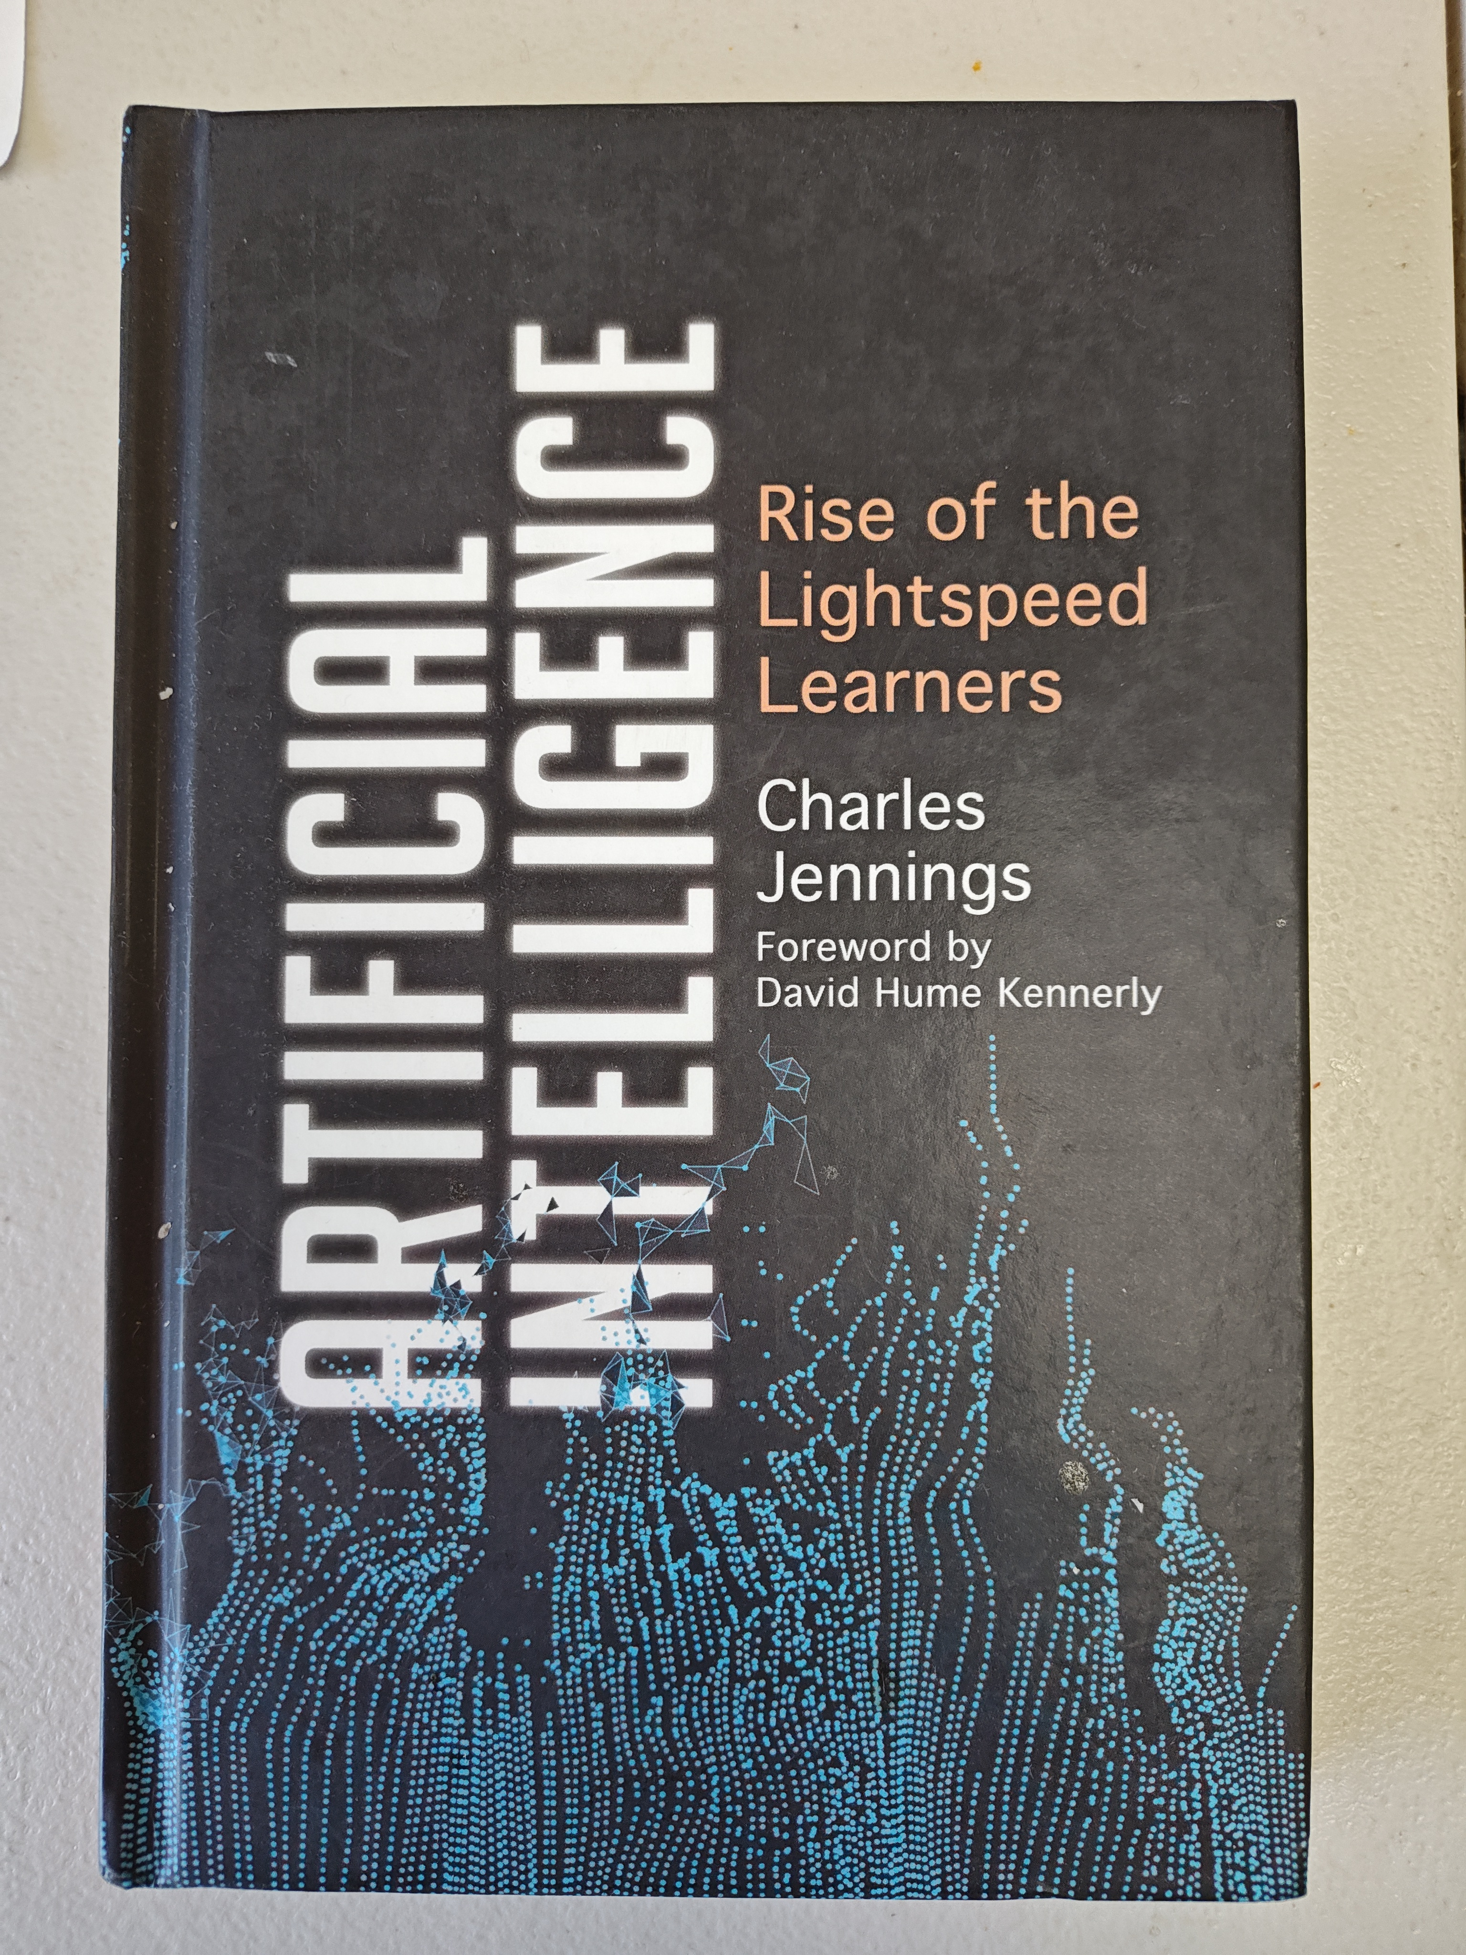
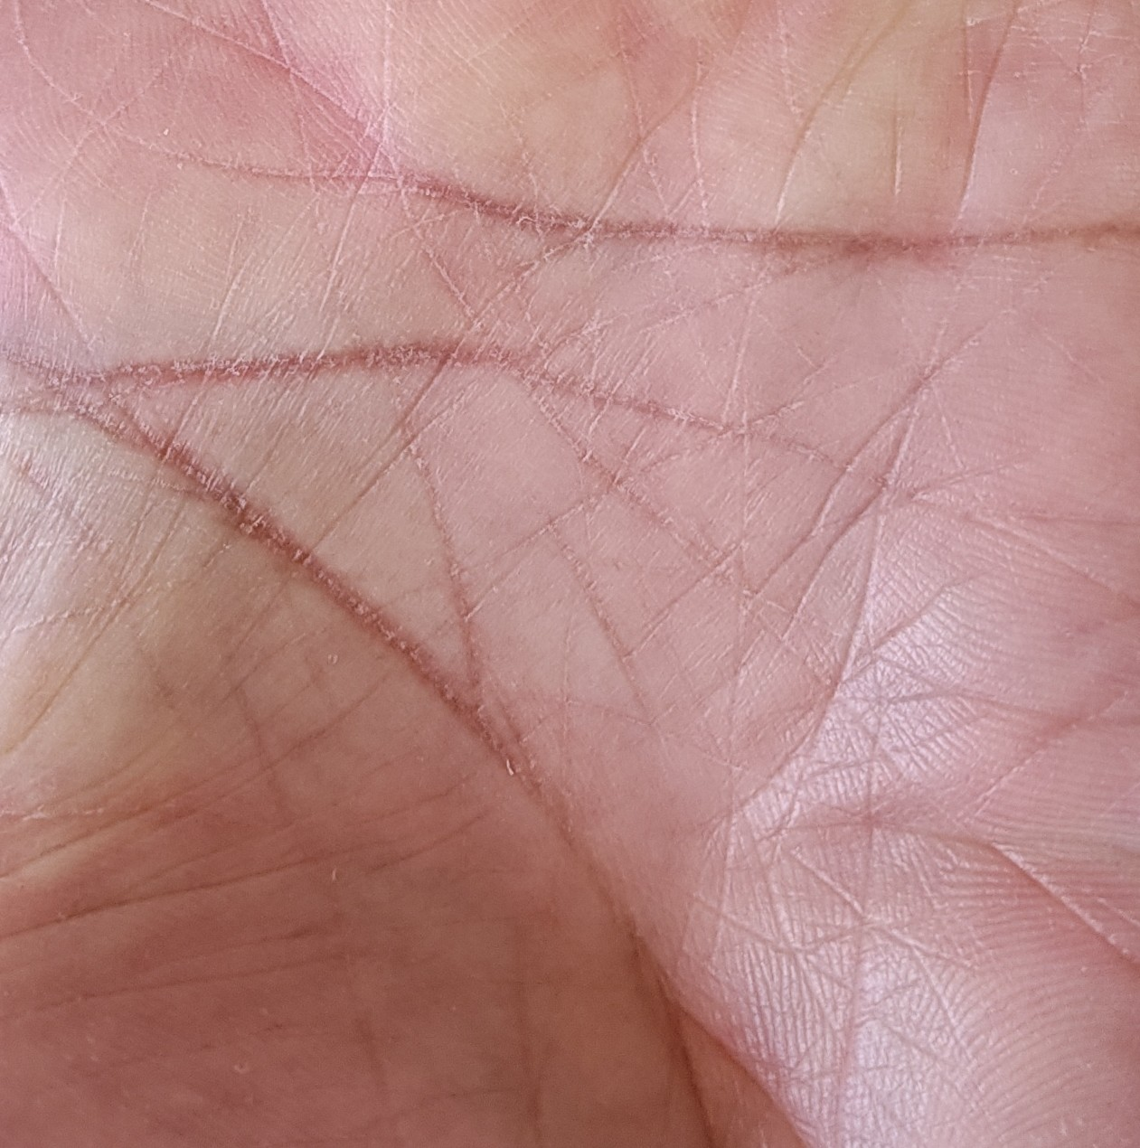
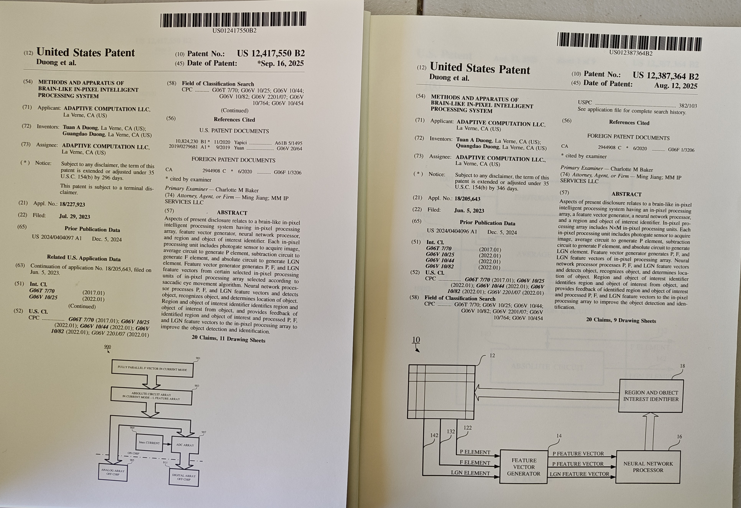
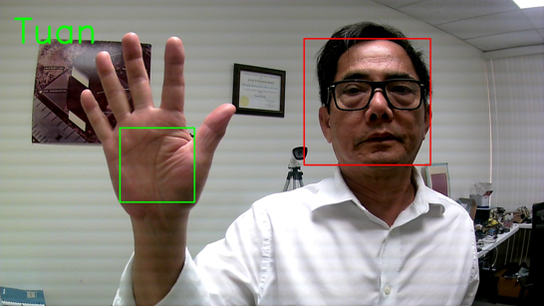
Credibility
Media:
Book to experience and test with the ADC algorithm entitled “Artificial Intelligence: Rise of the Lightspeed Learners” by Charles Jennings, 2019 .
2025
Press release 2025
https://www.prlog.org/13085112-bio-inspired-technology-dynamic-and-adaptable-for-unknown-real-world-environments.html
a leading provider of bio-inspired AI technology aiming to tackle detecting and tracking elusive objects of interest across air, land, and space domains today announced that it has achieved “Awardable” status through DARPA Expedited Research Implementation Series (ERIS) Marketplace. The ERIS Marketplace is The DARPA Expedited Research Implementation Series (ERIS) Marketplace is a transformative digital platform designed to accelerate acquisition velocity and advance national security innovation, 2025.
Selectable for sparse imager from AFWERX DP2 and in dialogue with DoD task.
Negotiating the license of palm ID to a commercial start-up company for banking security
Two patented US applications from the DARPA-AIE-IP2 Phase I and II tasks
2026
Press Release of June 4, 2026
https://www.einpresswire.com/article/917194974/adaptive-computation-llc-assessed- and -awardable-for-darpa-eris-marketplace
“Our solution “Real-Time Adaptive Tracking Systems for Irregular Target Moving Trajectory in a SWaP-C Approach”has been competitively assessed by the Defense Advanced Research Projects Agency (DARPA) and has been deemed “awardable” in the Expedited Research Innovation System (ERIS) Marketplace, making it available to view and easily procurable by the Department of War.”
Complete software and hardware for Face/Palm ID and commercial partner is evaluating it.
Confidential — Copyright © 2026 Adaptive Computation. All Rights Reserved.

Slide 4
Competitive Landscape in AI Processor
ADC’s HPU Engine
Nvidia GPU Engine
Hardware
Analog input and digital weight
Full Parralel In memory Computing- Instant Access
Multiplication and accumulation in parallel
Fully parallel access from sensory analog data
8-bit accuracy
Software
Proven bio-inspired unsupervised learning based on extended visual pathways (EViP) as short-term memory operation
Dynamic supervised learning as brain-based learning features: no constraints in data arrival and self-managed new class as long-term memory
→ Autonomous and self-intelligence at the edge
Software
CUDA library to enable parallelism of computation
Deep learning-based architectures for a statistical learning approach; hence, no intelligence system is enabled
→ No autonomous and manned managed intelligence
Hardware
Digital / Digital
Sequential Von-Neumann Architecture- moving data out from memory for computing
Multiplication, addition and accumulation in sequential
Sequential data assessment from sensory digital data
32- or 64-bit accuracy
Fast, low-power, and user-friendly engine and intelligence enabling approach
Slow, Power hungry and not User-friendly engine and no intelligence enabling
Co-Design software and hardware enables impeccable and unique products in the modern AI era.
Confidential — Copyright © 2026 Adaptive Computation. All Rights Reserved.

Slide 5
Market Size
AI Hardware
$25.4 Billion
$77 Billion
33%
Market in 2027
33% for net revenue
ADC annual ecosystem
AI Edge Hardware
$30 Billion
33%
$10 Billion
Co-processor
Sales as OEM
30$ /co-processor system and 33% for net revenue
ADC annual
ecosystem
Camera Sensor
39 Billion
$13 Billion
33%
Market in 2027
33% for net revenue
ADC annual ecosystem
Confidential — Copyright © 2026 Adaptive Computation. All Rights Reserved.

Slide 6
Team
Dr. Tuan Duong – CEO and CTO
  26 of year Neural Network S/H-Ware veteran at NASA and 15 years at ADC
  Holds 20 patents (Caltech/NASA and ADC) and 30 NASA New Technology Reports
  Passion and innovative in neural networks for ‘true’ intelligent system
Dr. Nam Trang– Data Science Manager
  Ph.D. UC Berkeley
  Several NSF Career grants
  Young and full energy for challenging tasks.
Dr. Allen R. Stubberud- VP-Advisor
  Dean and Prof. at UCI
  Former Chief scientist of Air Force
  Experienced and wisdom.
Confidential — Copyright © 2026 Adaptive Computation. All Rights Reserved.

Slide 7
MILESTONES
Develop and test chip 1* and 2**
Integrate sparse sensor HPU as discrete system
Beta test for HPU
Sale Sparse sensor
Integrate Sparse sensor and HPU as SOC
Sale SOC HPU to DoD
Marketing and sales sparse sensor and SOC HPU board level for edge system for commercial application
Marketing and sales in three OEM markets:
Cell phone, computers and servers
Acquisition
or
prepare for IPO
2027
2028
2029
2030
2031
* Sparse sensor
** Hybrid In-memory Processing Unit (HIPU)
Confidential — Copyright © 2026 Adaptive Computation. All Rights Reserved.

Slide 8
ASK
$20.0 million raise
use of funds
Chip, Board Development, Marketing, Front-end Development, Patents,
Key Hires
Exit potential
2031
Confidential — Copyright © 2026 Adaptive Computation. All Rights Reserved.

Slide 9
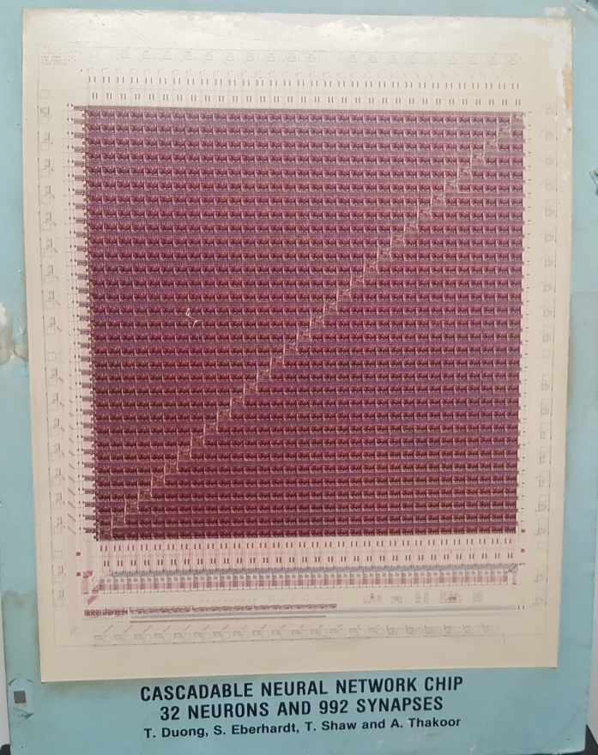
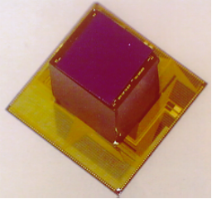
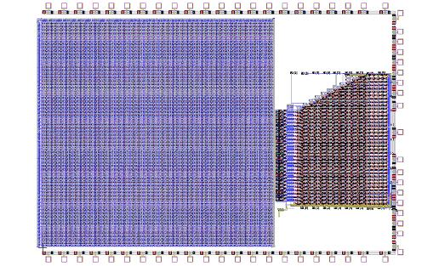

Background
(all these works are done in-memory architecture)
NASA
Year 1990- Successfully developed and tested 992 synapse array and 32 neurons Neural Network chip for associative memory using neural network feedback mode.
Year 1994- Modified version of 1990 neural network chip successfully launched on STRV-1b to study on-chip learning capability to adapt the total dose in the radiation environment-the first neural network chip flew to space—NASA task.
DOE
Year 2000- Successfully developed and tested 128x128 RGB color array and 28x10x5 cascade neural network processor on a chip (Soc) for DOE task as subcontractor for IOS.
BMDO
Year 1997- Successfully developed and tested a chip level for 3-D stacking chip (64x64x64 8-bit synapse array)
NASA
Real chip here
BMDO
DOE
28x10x5 Cascading Neural Network Processor
128x128 RGB APS sensor
Dr. Duong (who was the first to work on in-memory processing 30 years ago) was the cognitive architect and engineer for these projects and successfully wrote the learning software for the first neural network chip flow into space
Confidential — Copyright © 2026 Adaptive Computation. All Rights Reserved.

Slide 10
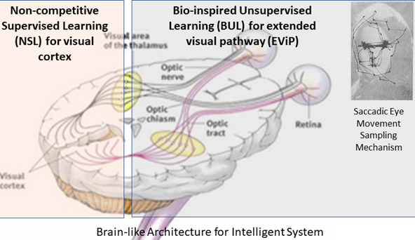
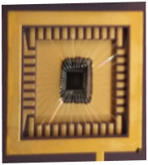
ADC Technology Innovations
ViCFA Software — Brain like Learning as long-term memory
Adapted the learning object without competition in natural mode, Visual Cortex Function Approximation (ViCFA) is initiated and developed to achieve:
Fast learning
Sequential Learning as data available—No redo learning
No constraints in sample data
Universal optimal architecture
Autonomy
Basic Benchmarks are validated and advanced in fast, on-line, and autonomous learning, to meet the intelligence at the edge processing.
EViP Software—Brain-like Extraction image as short-term memory
Inspired by the mammalian visual system, ADC integrates a saccadic eye movement emulator with a model of the biological visual pathway, namely Extended Visual Pathway (EViP) to enable real-time processing for the detection and recognition of a single-glance-on- object database, given inputs that are:
partial-view or full-view
low resolution or “noisy”
incomplete or “collage” style
sketches of actual objects
Benchmark tests show this system exceeds human visual performance in “Rank 1” recognition tests with the same single-glance-on-object database .
Hybrid Processor Unit and sparse Imager:
Analog + digital on one chip enables:
low power and optimal computation
parallel computation→ high speed
compact architecture
Revolutionary digitally-refined analog architecture puts “the best of both worlds” on a single chip, providing high speed, high performance, and low power consumption in a device that fits in smart phone slot.
3 US patents
2 Pending patent
International patent
2 US Patents
The brain-like Intelligent System (BIS) combination of software and hardware will provide unique advantages in technology for machine intelligence, perception and cognition, especially for handheld and edge computing applications.
Confidential — Copyright © 2026 Adaptive Computation. All Rights Reserved.

Slide 11
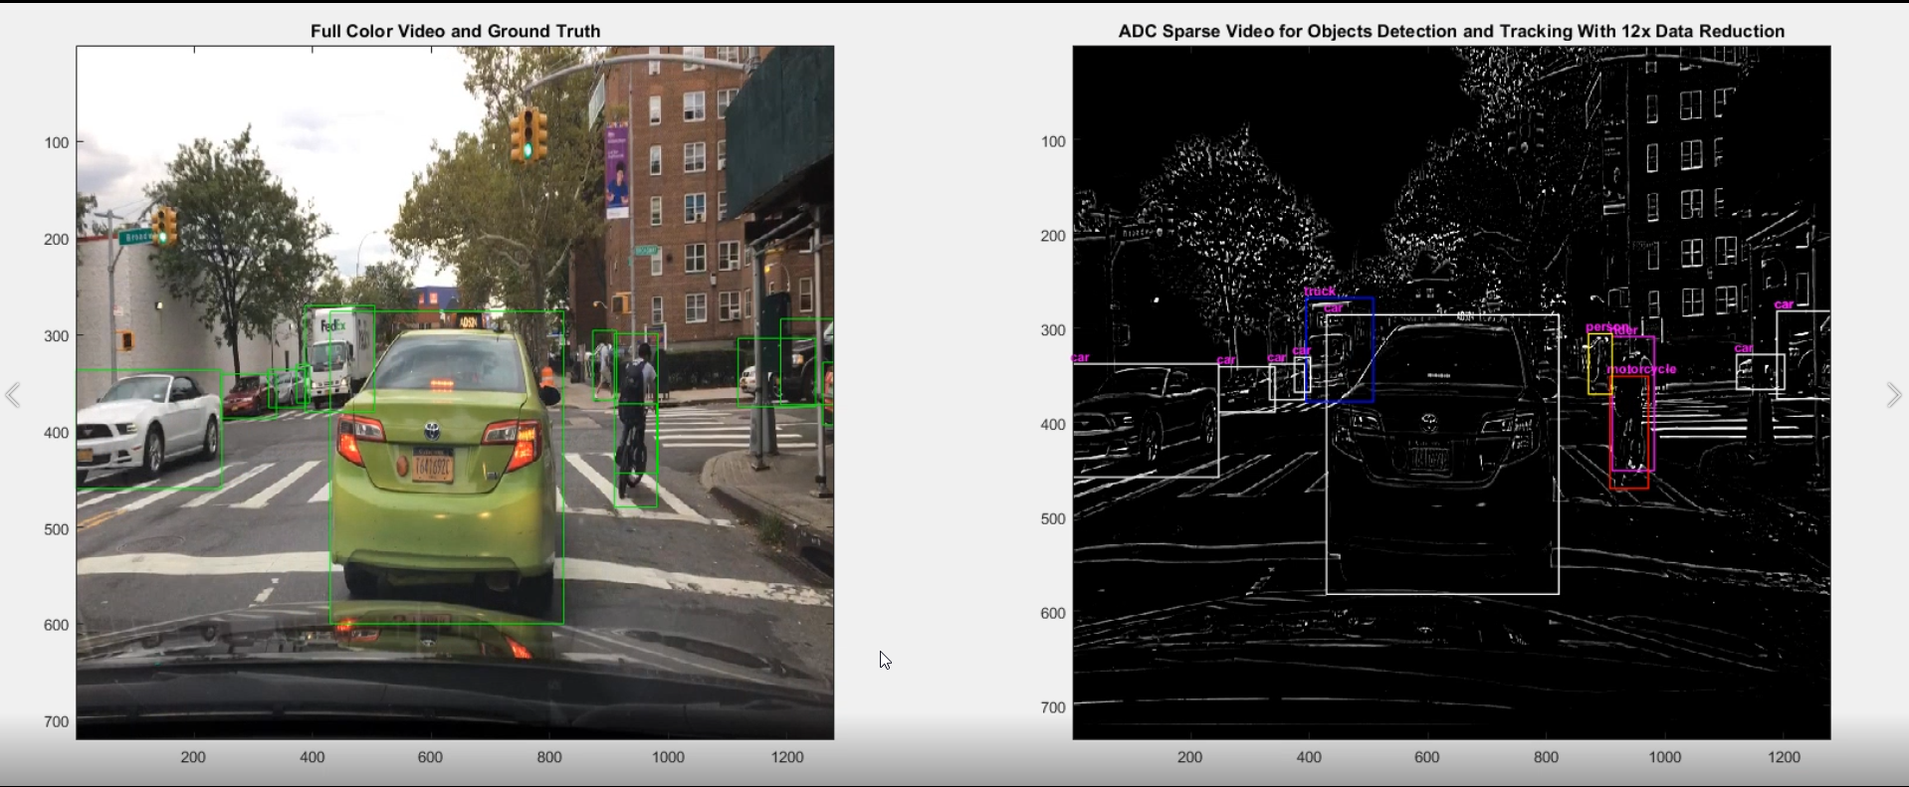
AIE DARPA IP2 Program Results (Phase I and II)
AIE is ai exploration program in third wave (while Deep Learning is a second wave) in Defense advanced research program agency (DARPA)-the revolutionary research program in us
Sparse sensor using ADC-extended visual pathway (EViP)* patented by ADC, to provide sufficient information as equivalent to full color sensor, to harvest low power consumption and fast computation due to much less data (60x reduction).
Who cares?
Drone, Edge system, space commercial and military applications.
* Tuan A. Duong, Vu A. Duong and Allen R. Stubberud, “Shape and Color Features for Object Recognition Search,” Handbook of Pattern Recognition and Computer Vision, Chap. 1.5, Ed. C.H. Chen, 4th Edition by World Scientific Publishing Co. Pte. Ltd, Jan 2010.
Confidential — Copyright © 2026 Adaptive Computation. All Rights Reserved.

Slide 12
Hybrid In-memory Processing Unit (HPU)—opportunity
Define the AI hardware market with the innovative approach.
Set a cornerstone in the AI landscape in the future, specially for edge and space applications.
Open the door for self-training data generation and self-learning for exploratory mission in space with ADC software approach.
Nvidia is dominating in AI GPU processors, but the technology is drawback by using Von Neumann architecture and digital information.
This opens a new direction for in-memory computing (DARPA is heading now) and a hybrid approach.
Dr. Duong has been working on this approach* for over 30 years, and we flew a learning device in space to adapt to the radiation environment in STRV-B in 1994. He holds the key technologies in hardware and software.
* Tuan A. Duong, S. Kemeny, T. Daud, A. Thakoor, C. Saunders, and J. Carson, “Analog 3-D Neuro-processor for Fast Frame Focal Plane Image Processing,” The Industrial Electronics Handbook, Chap. 73, Ed.-In-Chief J. David Irwin, CRC PRESS, 1997.
* Tuan A. Duong, S.P. Eberhardt, T. Daud, and A. Thakoor, “Learning in neural networks: VLSI implementation strategies,” In: Fuzzy logic and Neural Network Handbook, Chap. 27, Ed: C.H. Chen, McGraw-Hill, 1996.
Confidential — Copyright © 2026Adaptive Computation. All Rights Reserved.

Slide 13
Competitive Landscape in SENSORY DATA
ADC proved that sparse data using EViP which is reduced 60x intensity data is equivalent full resolution
Current Practice
Full color image is used
Sparse data requires less computation; hence it enables fast and low power requirements
Abundant data requires more computation to produce slow and power-hungry demands
ADC brings new technology sparse data using EViP to define a new sensory data direction for future use.
Confidential — Copyright © 2026 Adaptive Computation. All Rights Reserved.

Slide 14
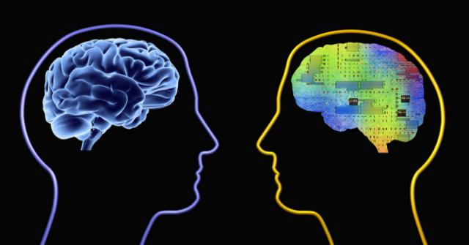
Human Visual System (HViS) vs. Extended Visual Pathway (EViP)-HIP
For a single-sample database, detailed testing has shown that ADC’s EViP system can match human visual system performance (75% correct) in a face recognition task involving a database with 1,000 distractors. With 10,000 distractors, EViP outperforms HViS, providing 66% versus 24% correct recognition in rank 1. However, HViS is still more flexible and versatile to outperform EViP in rank 10.
Distractors | 1K-Rank1 | 10K-Rank1 | 10k-Rank 10
HViS* | 75% | 24% | 91.1%
EViP | 75% | 66% | 78.5%
*http://megaface.cs.washington.edu/results/humanstudy.html
This technology is recognized as a new AI direction in the book entitled “Artificial Intelligence: Rise of the Lightspeed Learners” by Charles Jennings. (https://www.amazon.com/Artificial-Intelligence-Rise-Lightspeed-Learners/dp/1538116804 ).
Confidential — Copyright © 2026 Adaptive Computation. All Rights Reserved.

Slide 15
Intellectual Property
ADC I.P. (fully owned or licensed from Caltech):
US patent, “Artificial Intelligence Systems for Identifying Objects,” T. A. Duong, V. A. Duong and Allen R. Stubberud, Patent Number: 7,711,157 Issued: 5/4/2010 (Caltech Assignee).
US Patent, “Method and System for Object Recognition Search,” T. A. Duong, V. A. Duong and A. R. Stubberud, Patent No. 8340435, Issue Date Dec. 25, 2012 (Caltech Assignee).
US patent, " Compressive Sensing based Bio-Inspired Shape Feature Detection CMOS Imager," T. A. Duong, Patent No. 8,976,269, Issue Date March 10, 2015 (Caltech Assignee).
US patent, "Image Integration Search Based on Human Visual Pathway Model," Tuan A Duong, Patent No. 9,846,808, Issue Date December 19, 2017 (ADC Assignee).
US patent, “Systems and methods for object recognition based on human visual pathway”, Tuan A Duong, Patent No 10133955, Patent date Issued Nov 20, 2018 (ADC Assignee)
US patent, "Image Integration Search Based on Human Visual Pathway Model," Tuan A Duong, Patent No. 9,846,808, Issue Date May 16, 2019 (ADC Assignee).
US Pending, “Dynamic Neural Distribution Function Machine Learning Architecture,” US-20240220788-A1, T.A. Duong and QN. Duong, July 4, 2024 (ADC Assignee).
US Patent, “Methods and Apparatus of Brain-like In-pixel Intelligent Processing Systems", US 12387364 B2, T.A. Duong and QD. Duong, Aug 12, 2025 (ADC Assignee).
US Patent, “Methods and Apparatus of Brain-like In-pixel Intelligent Processing Systems-Architecture", US12417550 B2, T.A. Duong and QD. Duong, Sept 16, 2025. (ADC Assignee).
International Patent, “Dynamic Neural Distribution Function Machine Learning Architecture,” PCT/US2023/084846, T.A. Duong and QN. Duong, 25 Jan 2024.
Confidential — Copyright © 2026 Adaptive Computation. All Rights Reserved.

Slide 16
Market Estimation for AI Hardware
According to Global Market Insights Inc. (GMI), the global AI Hardware market size was estimated at USD 59.3 billion in 2024. The market is expected to grow from USD 66.8 billion in 2025 to USD 296.3 billion in 2034, at a CAGR of 18%. https://www.gminsights.com/industry-analysis/ai-hardware-market?utm_source=chatgpt.com
Investment in Edge AI hardware
The global edge artificial intelligence chips market size was valued at USD 3 billion in 2024 and is estimated to grow at 24.8% CAGR from 2025 to 2034. The growth of the market is attributed to the increasing demand for semiconductors and the increase in the adoption of IoT technologies. (https://www.gminsights.com/industry-analysis/edge-artificial-intelligence-chips-market?utm_source=chatgpt.com )
Market Estimation for Image Sensor Market
The Image Sensor Market size is projected to reach USD 38.6 billion by 2027 from an estimated USD 26.1 billion in 2022 at a CAGR of 8,1% from 2022 to 2027. https://www.marketsandmarkets.com/Market-Reports/Image-Sensor-Semiconductor-Market-601.html
Confidential — Copyright © 2026 Adaptive Computation. All Rights Reserved.

Slide 17
Go to Market
PR/Marketing
Tech show
Electronic consumer third parties
Tech magazines
Google/Facebook ads
Retail co-marketing
Affiliate programs
Confidential — Copyright © 2026 Adaptive Computation. All Rights Reserved.

Slide 18
Where are we?
Product Timing Projection
 | Estimated ready in | What we need
Chip Development and Test | Stage 1:12 months Stage 2: 13:24 months | Develop, test, integration and marketing
Board application Development Chip optimization and test | 25-30 months Stage 3: 31-39 months | Marketing team Fine-tune, test, integration and marketing
OEM ready for Edge device, Phone, Computers and Servers | 40-48 months | Marketing for sales
Product upgrade and IPO | 49-60 months | IPO or Acquisition
Software
All software in supervised and unsupervised learning are developed.
Unsupervised Learning is optimized
Supervised is under optimized
Integration is on going
Hardware
Chip architecture is well-defined
Component designs are initiated
Confidential — Copyright © 2026 Adaptive Computation. All Rights Reserved.

Slide 19
FINANCIALS
 | Year 1 | Year 2 | Year 3 | Year 4 | Year 5
Sales Revenue | $250,000 | $1,500,000 | $40M | $250M | $1B
Operating Expense | 6,000,000 | 10,500,000 | 35M | 50M | 200M
EBITDA | (5,750,000) | (9,000,000) | 5M | 200M | 800M
Series A | 20M
Series B |  |  | 50M
Confidential — Copyright © 2026 Adaptive Computation. All Rights Reserved.

